Slide 1


Apprenticeship Embedded Degree Programs (AEDPs)
Academic year 2026-27

Slide 2
What is Apprenticeship Embedded Degree Programs (AEDPs)?
अप्रेंटिसशिप एम्बेडेड डिग्री प्रोग्राम (AEDP) क्या है?
Features of AEDP
UGC Approved Courses
University will award Degree
Valid for Government Exams and Higher Studies
Curriculum as per the National Education Policy
Scholarship will be applicable
Students will get Stipend during apprenticeship (minimum ₹ 12,300/- per month)
3 वर्षीय डिग्री प्रोग्राम
शिक्षण संस्थान में पहले दो साल की शैक्षणिक शिक्षा
(Theory)
अंतिम वर्ष में उद्योग में प्रशिक्षुता (Apprenticeship)

Slide 3
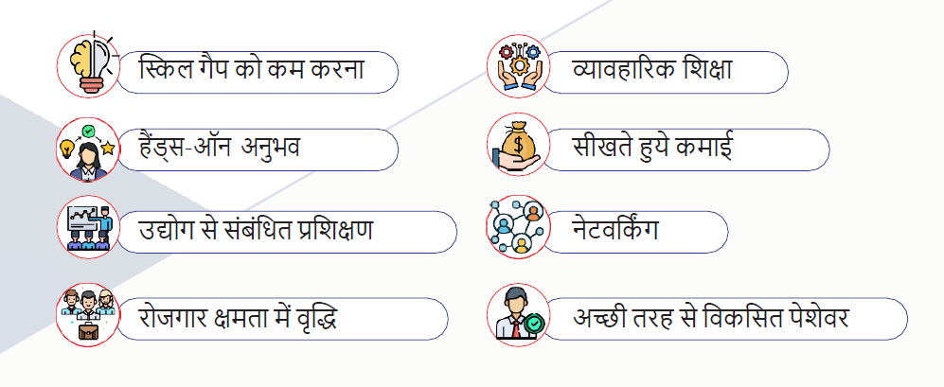
Benefits of AEDPs

Slide 4
Overview of AEDP since AY 24-25 to 25-26
During the academic year 2025-26, 10 AEDP courses across 7 Sector Skill Councils were offered in 133 colleges and 12 universities.
The Board of Apprenticeship Training (BOAT) facilitated final-year apprenticeships for students through the NATS Portal. In accordance with UGC guidelines, BOAT signed individual MoUs with participating colleges and universities.
Students undertaking apprenticeships during their final year received a minimum monthly stipend of ₹12,300.
Unlike the previous academic year, when AEDP courses were offered under the self-financing model, the course fees for 2025-26 were aligned with the regular fee structure applicable to general B. A, B. Com, and B. Sc. programs.
Total admissions in AEDP courses increased from 1,152 in 2024-25 to 4,448 in 2025-26.
A total of 91 students from the 2024-25 batch were placed for apprenticeships, while the placement process for the remaining eligible students continued.

Slide 5
Overview of AEDP Admissions
Admissions data for academic Year 2024-25
AEDPs | Retail | BFSI | Pharma | Logistics | Healthcare | HRO | Total
Colleges onboarded | 23 | 10 | 3 | 4 | 2 | 5 | 47
Students enrolled | 501 | 346 | 57 | 121 | 46 | 81 | 1152
Admissions data for academic Year 2025-26
AEDPs | Retail | BFSI | Pharma | Logistics | Healthcare | HRO | Tourism | Total
AEDPs with admissions | 30 | 37 | 10 | 8 | 25 | 6 | 17 | 133
Students enrolled | 948 | 1487 | 391 | 283 | 609 | 149 | 621 | 4488

Slide 6
Overview of AEDP 2026-27
Admissions data for academic Year 2026-27
AEDPs | Retail | BFSI | Logistics | Healthcare | HRO | Tourism | Total
Colleges onboarded | 27 | 32 | 5 | 24 | 10 | 11 | 109
Students enrolled | 192 | 668 | 77 | 111 | 55 | 18 | 1121
7500+
Target Admissions
1121
Total Admissions 26-27
91
Apprenticeships 24-25
430+
Industries Onboarded

Slide 7
शैक्षणिक सत्र 2026-27 से AEDP के अंतर्गत पाठ्यक्रम
B. Com / B. A BFSI [BANKING FINANCIAL SERVICES & INSURANCE]
B. Com LOGISTICS
B.Sc. / B. Com DIGITAL MARKETING & ADVERTISING
B. Sc HEALTHCARE MANAGEMENT
B.A CONTENT & CREATIVE WRITING
B. Com HUMAN RESOURCE OPERATIONS
B.A / B. Sc / B. Com REAL ESTATE & PROPERTY MANAGEMENT
B. A TOURISM & HOSPITALITY OPERATIONS
B. A / B. Sc / B. Com SUSTAINABLE CONSTRUCTION & INFRASTRUCTURE
B. Com RETAIL OPERATIONS MANAGEMENT
B. Sc / B. Com CONSTRUCTION PROJECT MANAGEMENT
B.A / B. Com / BBA EVENT MANAGEMENT

Slide 8
Why Apprenticeship Training through NATS?
Immersive ‘on-the-job’ industry experience
Minimum Stipend mandated for a year
Quarterly performance reviews
Govt. share of stipend up to 50% of minimum mandate
Equivalent to job experience
Stipend payment through DBT
Issuance of Certificate of Proficiency
NATS 2.0 portal for all processes
NATS is implemented across Madhya Pradesh through it’s regional Boards of Apprenticeship Training:
BOAT (Western Region)
In the last five years, NATS has provided apprenticeship opportunities to 12.94 lakh candidates

Slide 9





















BOAT (WR) Presence across Madhya Pradesh

Slide 10
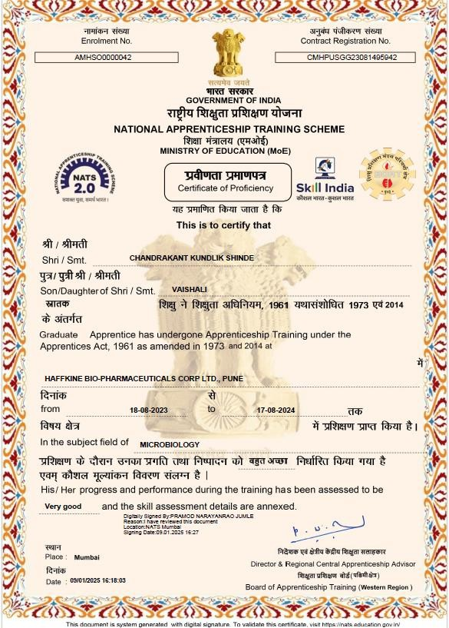
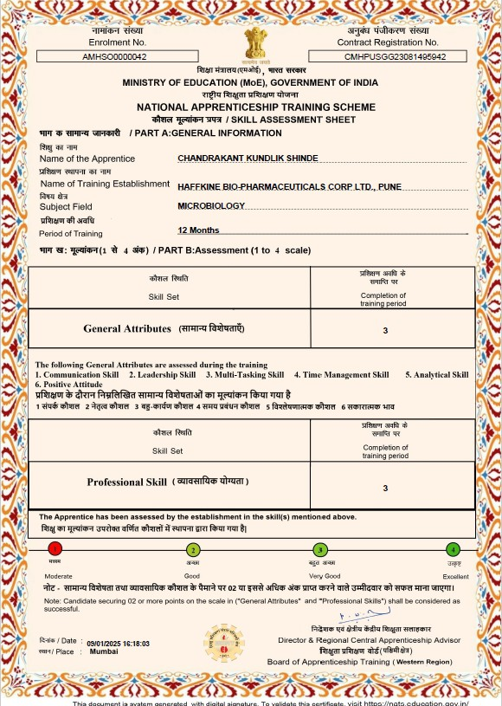
“Certificate of Proficiency”
awarded after successful completion of apprenticeship training
General Attributes
Professional
Skills

Slide 11

Thank You
Swapnil Singh
CRISP Fellow, 2026
swapnil@crispindia.net
+91 81090 33689
Arghya Mondal
CRISP Fellow, 2026
arghyamondal@crispindia.net
+91 89181 06564
Pooja Kapoor
State Lead, CRISP
poojakapoor@crispindia.net
+91 98930 20001
Swapnil Mohan
Associate, CRISP
swapnilmohan@crispindia.net
+91 95848 59879

